Slide 1
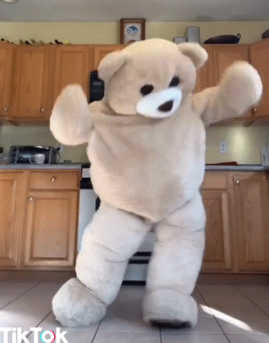
Team Pacman

Slide 2

Brainstorming for Team names
Team Pacman
The Futuristics

Slide 3
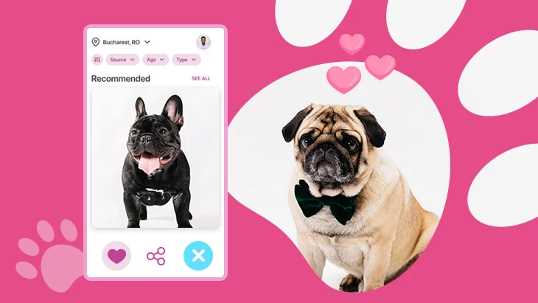
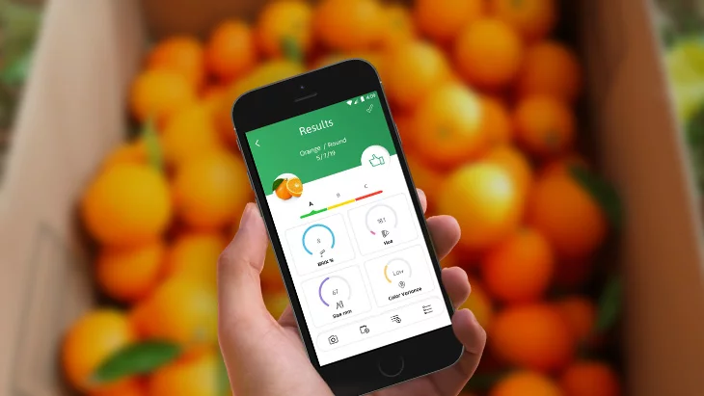
Brainstorming for further Apps
Tinder for Pets 😅
Quality Monitoring App for Vegetables and Fruits

Slide 4


Slide 5
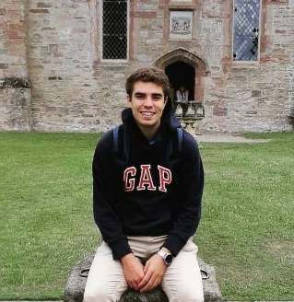
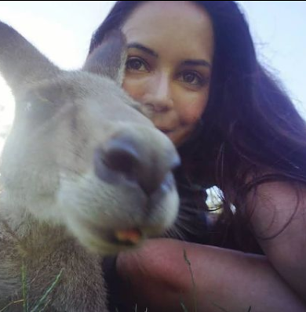
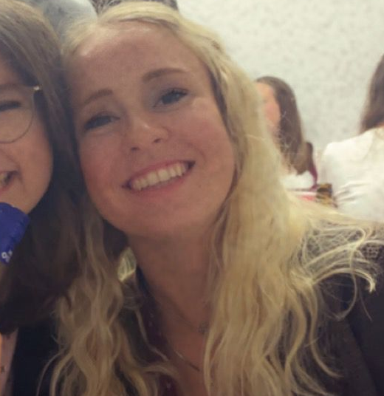
Team Pacman
*Sergi
*Chrissi
*Julia

Slide 6
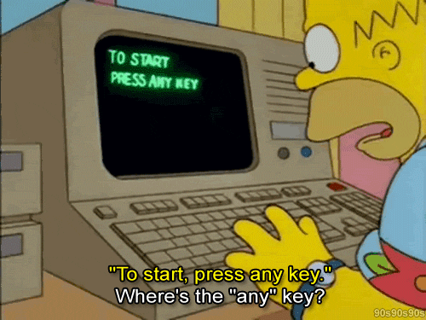
Good user interaction is…

Slide 7
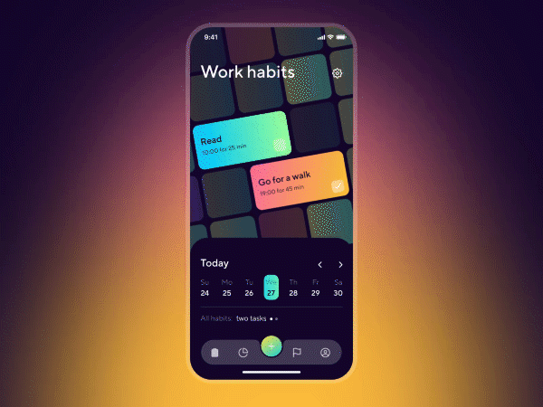
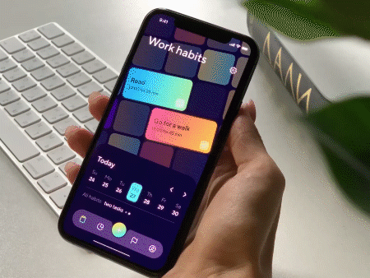
… clear and intuitive user navigation
*App: Habit Builder App

Slide 8
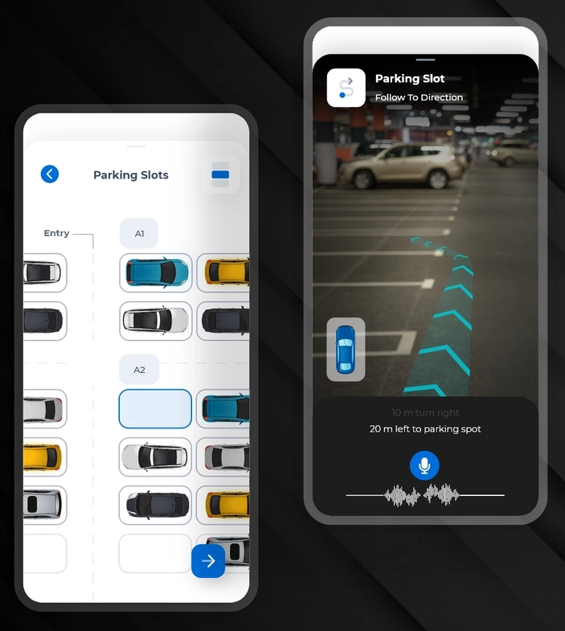



Charge my Car!
- parking spots for e-cars -
Our goal is to let drivers easily find a parking spot,
charge their electric car & make an advance payment.
no more wasted time!
Target group: Drivers with an electric vehicle
easy Payment
https://dribbble.com/shots/15712543-Latest-Smart-Parking-App-UI-Design

Slide 9
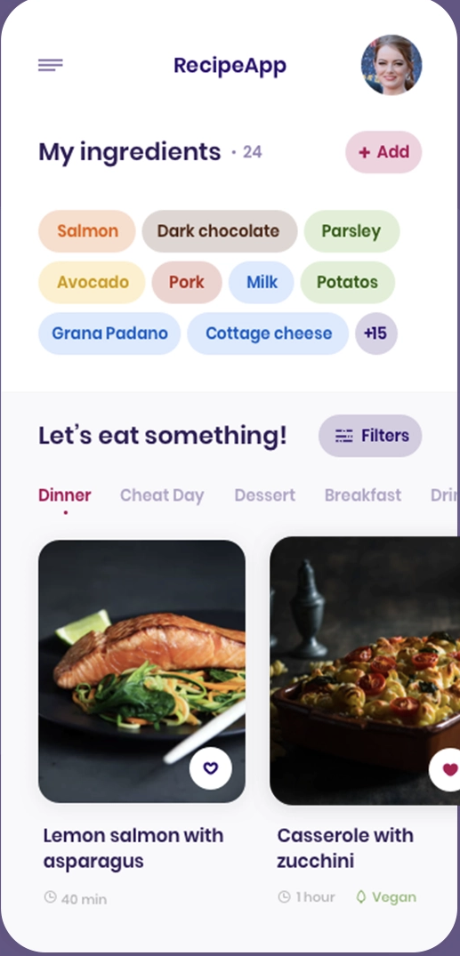
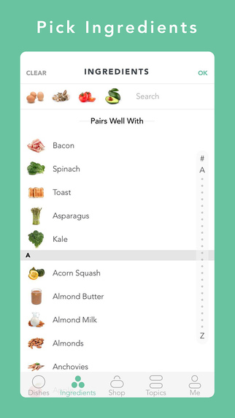
FOODIYO
Discover new recipes
The goal of the app is for people to discover new recipes with the ingredients they have already at home.
App designed for everybody, but more focused on the youth.
Possibility to scan your own fridge, select different food/diet types or the duration of meal.
https://www.geekwire.com/2015/app-of-the-week-handpick-finds-recipes-for-the-ingredients-in-your-fridge/
https://dribbble.com/shots/7170152-Smart-Recipes

Slide 10
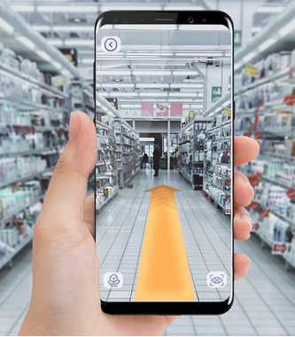
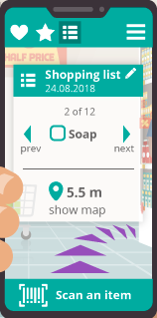
ShopExpert - your personal supermarket navigator
AR Navigation through supermarkets
and other stores
simple and efficient sorting of your items
Scanning of items to easily add them to
your shopping list
Automatic selection of the closest store
offering all items
for anyone who is tired
of wasting too much
time for shopping
https://www.scnsoft.com/blog/augmented-reality-in-retail
https://augray.com/blog/augmented-reality-solutions-to-engage-in-store-shopping/supermarket_way_01/

